Slide 1
CDP410 – Using Kubernetes
July 25, 2017
Benny Bustan
Principal Technology Development

Slide 2
You are HERE!
CDP101 – Introduction to MicroServices
CDP202 – Domain Driven Design
CDP103 – Introduction to the Continuous Deployment Platform
CDP104 – Introduction to Standard Tools and Frameworks
CDP205 – Using the MicroServices Catalog
CDP206 – Developing an Application Using MicroServices
CDP207 – Developing MicroServices
CDP308 – MicroServices Problem Determination and Monitoring
CDP409 – Using Docker Containers
CDP410 – Using Kubernetes
101
202
103
104
205
206
207
308
409
You are HERE
410

Slide 3
Quick View Page
Your Course Outline
Kubernetes: Overview
Introduces the basic concept of Kubernetes.
YAML Files
How to use YAML files to configure Kubernetes cluster.
AJSC6 Deployment
AJSC6 Docker image deployment using Kubernetes.
Cluster Management
High Level overview of monitoring tools part of CDP Runtime environment.
Services, Load Balancing and Networking
Introduces the Networking & High Availability concept of Kubernetes.
Your Course Overview
This course explains how Kubernetes is being used part of CDP runtime environment and especially when using AJSC6. You can work through the course at your own pace. It may take 1 to 2 hours to complete this course, including the self-check exercises.
Intended Audience
Operations, Developers and Architects
Prerequisites
CDP207, CDP409
Notes:
Kubernetes: Overview
YAML Files
AJSC6 Deployment
Cluster Management
Services, Load Balancing, and Networking

Slide 4


Before You Start
You’ll need to see both the slide and the notes section below. If you don’t see the notes section, click on “Notes Page” within the “View” tab. If viewing the presentation as a slide show, you may also see the notes on the presenters page.
Notes are not visible using the PowerPoint Viewer.
Notes:
These slides have a significant amount of notes added to them to explain the content. This is done so that reading the notes is essentially what an instructor leading the course would have said. There is a good amount of explanation in the notes that may be missed if you look only at the slide.
The notes can be viewed using several different approaches. If you are viewing the presentation as a slide show, the presenters view will show the slide and the notes. If you have opened the presentation in PowerPoint, you can view the notes using one of several means:
Select the “View” menu, then select “Notes Page”
In the normal view, use your mouse to select a divider along the bottom of the slide and move it up. This will show both the slide and the notes.
Please note, if you are using the power point viewer, the notes will not be visible. You will need to use PowerPoint to view the presentation content in its entirety.

Slide 5
Contents
Kubernetes: Overview
YAML Files
AJSC6 Deployment
Cluster Management
Services, Load Balancing, and Networking

Slide 6
Kubernetes – Why?
The Need for Container Orchestration
Standalone Docker containers are good for managing a few containers running on a fewer hosts.
For a large scale production environment, there is a need to:
Provide for dozens of containers running on hundreds of hosts.
Automate the distribution of dozens of microServices.
Ensure higher levels of utilization & efficiency.
Kubernetes: Overview
Notes:
Kubernetes is an orchestration tool that manage the deployments of containers, but why do we need it?
In CDP409 Using Dockers, we saw we can easily run Docker commands to manage our micro services.
We can also use Chef or Ansible orchestration tools for creating recipes or playbooks that automate the deployments on several servers.
The question remains…why?
We need a robust orchestration tools that is more customized and easy to use for containers.
This tool should be able to support deployment automation, utilization management, high availability, and support large scale of containers running on hundreds of hosts.
Kubernetes does all of it.
.

Slide 7
Kubernetes Components
Kubernetes clusters are divided into multiple components….
Registry
Master components provide the cluster’s control plane.
Master components make global decisions about the cluster (for example, scheduling), and detecting and responding to cluster events.
It can be run on any node in the cluster. However, for simplicity, set up scripts typically start all master components on the same VM, and do not run user containers on this VM.
It can be accessible using a dashboard, API and Command line.
Master
Node 1
API
Node 2
UI
CLI
Node 3
Kubernetes: Overview
Notes:
A Kubernetes cluster is divided to multiple components:
Master components provide the cluster’s control plane.
Master components make global decisions about the cluster (for example, scheduling), and detecting and responding to cluster events.
It can be run on any node in the cluster. However, for simplicity, set up scripts typically start all master components on the same VM, and do not run user containers on this VM.
It can be accessible using a dashboard, API and Command line.
Node components run on every node, maintaining running pods and providing the Kubernetes runtime environment.
The Registry component stores the Docker container’s images.

Slide 8
Kubernetes Architecture
Shared Kubernetes deployment architecture, also known as CDP Runtime:
The CDP runtime environment is divided into several layers, in the descending order seen below:
Third Layer - Applications – Docker containers running different application on different clusters.
Overlay Layer - Cluster Management / Orchestration – The Kubernetes logic (master functionality)
Second Layer – Kubernetes Clusters – Kubernetes can run multiple clusters (namespaces) on the same VM hosts. Each project using AT&T Eco can onboard a shared Kubernetes cluster under its own namespace, or use CDP runtime to install private Kubernetes cluster on its own VPMO VM servers.
First Layer - Infrastructure – Bare Metal hardware running Virtual Machines – ITO Cloud or AIC Cloud
Cluster Management / Orchestration
Cluster 3
Cluster 4
Application
Application
Application
Application
Cluster 1
Cluster 2
Application
Application
Application
VM
VM
VM
VM
VM
VM
VM
VM
VM
VM
Infrastructure
Kubernetes: Overview
Notes:
The CDP runtime environment is divided into several layers:
First Layer - Infrastructure – Bare Metal hardware running Virtual Machines – ITO Cloud or AIC Cloud
Second Layer – Kubernetes Clusters – Kubernetes can run multiple clusters (namespaces) on the same VM hosts. Each project using AT&T Eco can onboard a shared Kubernetes cluster under its own namespace, or use CDP runtime to install private Kubernetes cluster on its own VPMO VM servers.
Third Layer - Applications – Docker containers running different application on different clusters
Overlay Layer - Cluster Management / Orchestration – The Kubernetes logic (master functionality)

Slide 9
Kubernetes Architecture
Kubernetes Terminology
Nodes
Hosts that run Kubernetes applications
Containers
Units of packaging
Pods
Units of deployment
Replication controllers
Ensure availability and scalability
Labels
Key-Value pairs for identification
Services
Collections of pods exposed as an endpoint
Config Maps & Secrets
Key-Value pairs for central configuration
Kubernetes: Overview
Notes:
Before we can look at how AJSC6 containers are being deployed on CDP runtime environment it is essential to understand the Kubernetes terminology

Slide 10
Kubernetes Architecture
Kubernetes Terminology – NODES
A node is a worker machine in Kubernetes.
A node may be a VM or physical machine.
Each node has the services necessary to run pods and is managed by the master component.
The services on a node include Docker, kubelet and kube-proxy.
Master
Node 1
Node 2
Node 3
Kubernetes: Overview

Slide 11
Kubernetes Architecture
Kubernetes Terminology – CONTAINERS
A container is a unit of packaging.
A pod can have 1 or more containers.
Kubernetes support various types of containers, Docker, Rocket and etc..
Master
Node 1
Container1
Container2
Container1
Node 2
Container2
Container1
Node 3
Container2
Kubernetes: Overview

Slide 12
Kubernetes Architecture
Kubernetes Terminology - PODS
A pod is a group of containers that are deployed together on the same host.
Pods operate at one level higher than individual containers.
A pod models an application-specific “logical host.” It contains one or more application containers which are relatively tightly coupled.
Master
Node 1
POD A
POD A
POD A
Node 2
POD A
POD A
Node 3
POD B
Kubernetes: Overview
Notes:
A Kubernetes pod is a group of containers that are deployed together on the same host.
If you frequently deploy single containers, you can generally replace the word "pod" with "container" and accurately understand the concept.
Pods operate at one level higher than individual containers because it's very common to have a group of containers work together to produce an artifact or process a set of work.
For example:
An app server pod that contains three separate containers: the app server itself, a monitoring adapter, and a logging adapter.
The logging and monitoring containers could be shared across all projects in your organization.
These adapters could provide an abstraction between different cloud monitoring vendors or other destinations.
Any project requiring logging or monitoring can include these containers in their pods, but not have to worry about the specific logic.
All they need to do is send logs from the app server to a known location within the pod.

Slide 13
Kubernetes Architecture
Kubernetes Terminology – REPLICATION CONTROLLERS
Master
Node 1
A ReplicationController makes sure that a pod or homogeneous set of pods are always up and available.
The pods maintained by a ReplicationController are automatically replaced if they fail, get deleted, or are terminated.
You can think of a ReplicationController as something similar to a process supervisor, but rather than individual processes on a single node, the ReplicationController supervises multiple pods across multiple nodes.
POD A
Replication
Controller
POD A
POD A
Node 2
POD A
POD A
Node 3
POD B
Kubernetes: Overview
Notes:
A replication controller is one of the features of Kubernetes that you'll interact with on a regular basis to launch one or more instances of your applications.
Replication controllers are "cheap" and you can have many of them configured in your cluster.
The logic of a replication controller is simple by design, but enables powerful, flexible deployment topologies for your development teams.
Each replication controller has a desired state that is managed by the application deployer. When a change is made to the desired state, a reconciliation loop detects this and attempts to mutate the existing state in order to match the desired state.
For example, if you increase the desired instance count from 3 to 4, the replication controller would see that one new instance needs to be created and launch it somewhere on the cluster.
This reconciliation process applies to any modified property of the pod template.

Slide 14
Kubernetes Architecture
Kubernetes Terminology - DEPLOYMENT
A Deployment provides declarative updates for pods and ReplicaSets (the next-generation ReplicationController).
An update for the Deployment object will trigger the deployment controller and will change the actual state to the desired state.
Master
Node 1
POD A
Deployment
Controller
POD A
POD A
Node 2
POD A
POD A
Node 3
POD B
Kubernetes: Overview

Slide 15
Kubernetes Architecture
Kubernetes Terminology – LABELS
Labels are key/value pairs that are attached to objects, such as pods.
Labels are intended to be used to specify identifying attributes of objects that are meaningful and relevant to users, but do not directly imply semantics to the core system.
Labels can be used to organize and to select subsets of objects.
Labels can be attached to objects at creation time and subsequently added and modified at any time.
Each object can have a set of key/value labels defined.
Each Key must be unique for a given object.
LABELS
Metadata with Semantic Meaning
Membership Identifier
Master
Node 1
DB
DB
FE
Node 2
Version 1.0
Version 1.0
Node 3
BE
Kubernetes: Overview
Notes:
Labels are key/value pairs that are attached to objects, such as pods.
Labels are intended to be used to specify identifying attributes of objects that are meaningful and relevant to users, but do not directly imply semantics to the core system.
Labels can be used to organize and to select subsets of objects.
Labels can be attached to objects at creation time and subsequently added and modified at any time.
Each object can have a set of key/value labels defined.
Each Key must be unique for a given object.

Slide 16
Kubernetes Architecture
Kubernetes Terminology - SERVICES
A service is a grouping of pods that are running on the cluster.
Services provide important features that are standardized across the cluster:
Load-balancing
Service discovery between applications
Zero-downtime application deployments
Master
Node 1
DB SRV
HTTP SRV
Node 2
HTTPS SRV
Node 3
Kubernetes: Overview
Notes:
A service is a grouping of pods that are running on the cluster.
Services provide important features that are standardized across the cluster: load-balancing, service discovery between applications, and features to support zero-downtime application deployments.
Services are "cheap" and you can have many services within the cluster.
Kubernetes services can efficiently power a microService architecture.
Each service has a pod label query which defines the pods which will process data for the service.
This label query frequently matches pods created by one or more replication controllers.
Powerful routing scenarios are possible by updating a service's label query via the Kubernetes API with deployment software.

Slide 17
Kubernetes Architecture
Kubernetes Terminology – CONFIG MAPS & SECRETS
Master
Node 1
Config Maps are used for central configuration.
They can be be assigned to pods.
They are mainly used for not-secret configuration data.
Secrets are the same as Config Maps, but are for things which are actually ‘secret’… like API keys, credentials, etc..
ConfigMap
ConfigMap
ConfigMap
Node 2
ConfigMap
ConfigMap
Node 3
ConfigMap
Kubernetes: Overview
Notes:
TBD – Add text

Slide 18
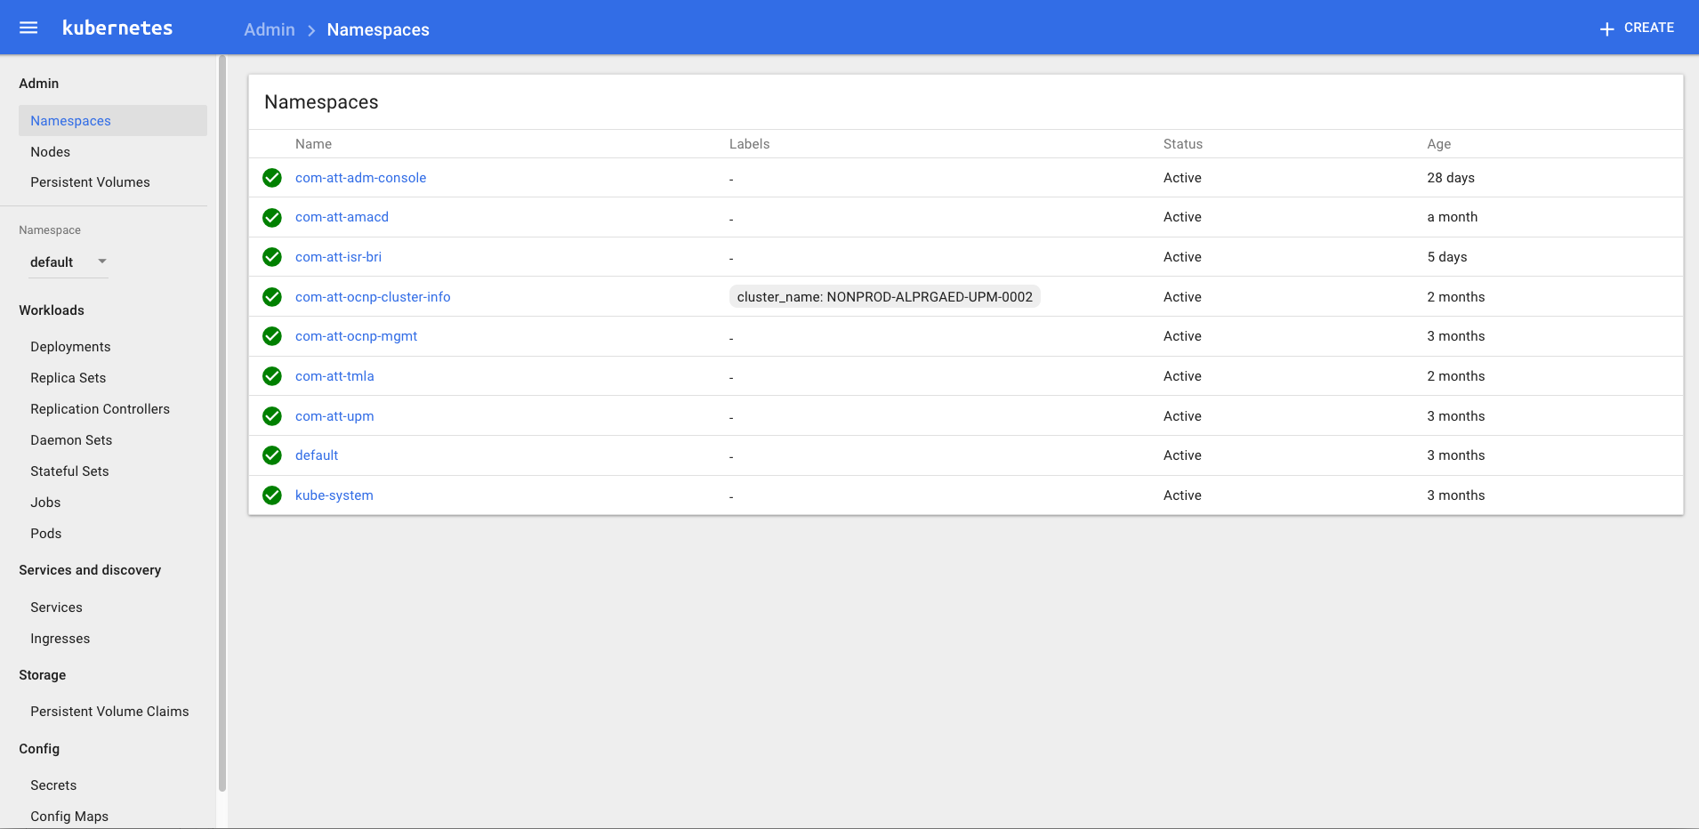
Kubernetes Architecture
Kubernetes First tour – Namespaces
Kubernetes: Overview
Notes:
Kubernetes has a very detailed user interface GUI.
In this example you can see that this Kubernetes cluster have several namespaces which are logical separation for different projects on the same cluster.

Slide 19
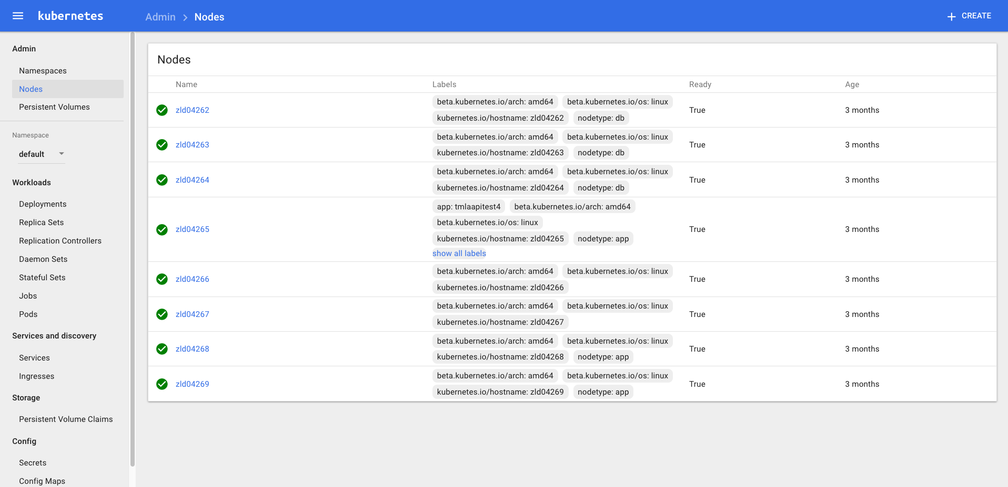
Kubernetes Architecture
Kubernetes First tour – Nodes
Kubernetes: Overview
Notes:
In this example you can see the Nodes associate with this cluster.
In this configuration, we have 2 masters and 6 nodes. The nodes are separated by ”nodetype” label.
3 of them are running database containers (db) and 3 of them running Applications (app).

Slide 20
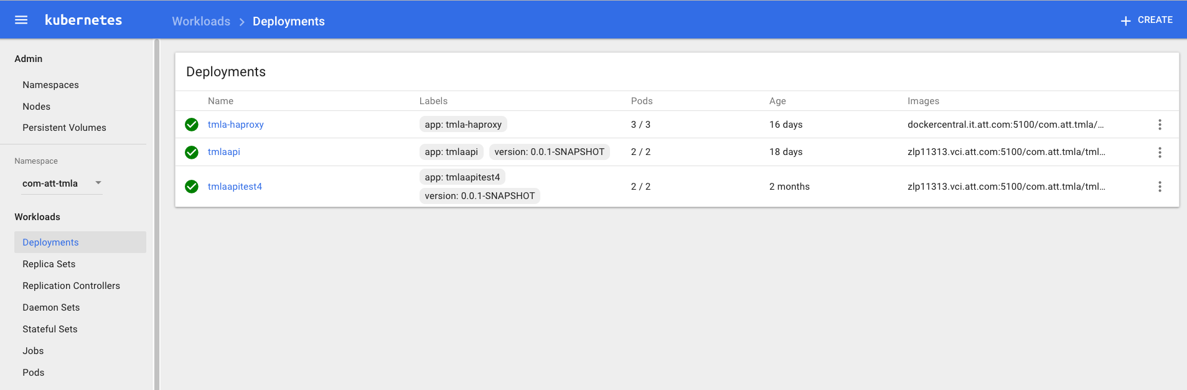
Kubernetes Architecture
Kubernetes First tour – Deployments
Kubernetes: Overview
Notes:
In this example we chose com-att-tmla namepsace and click on Deployments workloads, you can see we have 3 different deployments:
tmla-haproxy – a standard ha-proxy Docker container deployment
tmlaapi – AJSC6 container created by AT&T Eco.
tmlaapitest4 - AJSC6 container created by AT&T Eco.
Each deployment contains a set of replica sets and pods which we’ll see next.

Slide 21
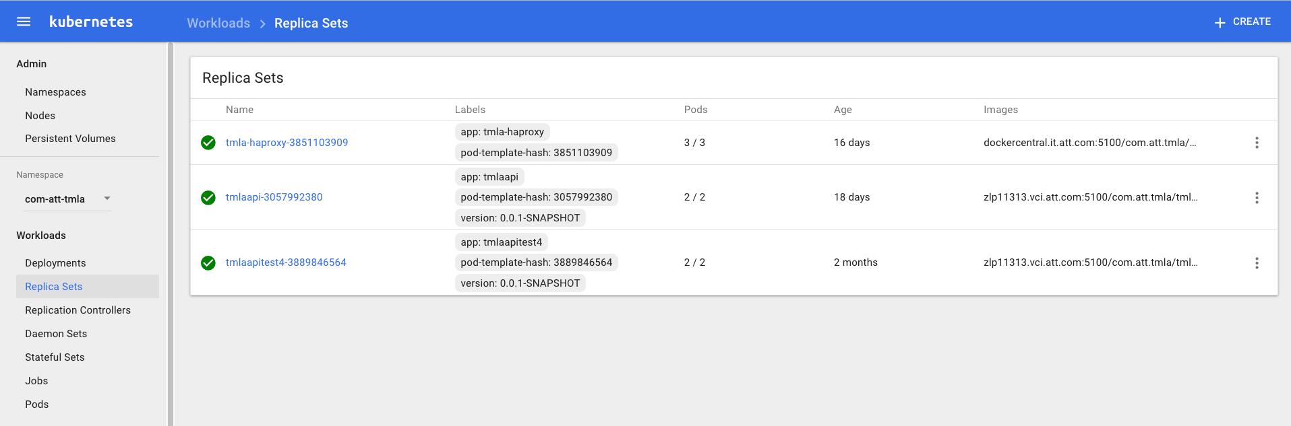
Kubernetes Architecture
Kubernetes First tour – Replica Sets
Kubernetes: Overview
Notes:
In the Deployment YAML files, you may specify how many replicas you want to have for your containers.
It manages the number of pods needed to be created.
It eventually creates replica sets.
In the example here, you can see that each deployment workload creates a replica set.
For tmla-haproxy, three pods are initiated.
For both tmla AJSC6 deployments, two pods are initiated.

Slide 22
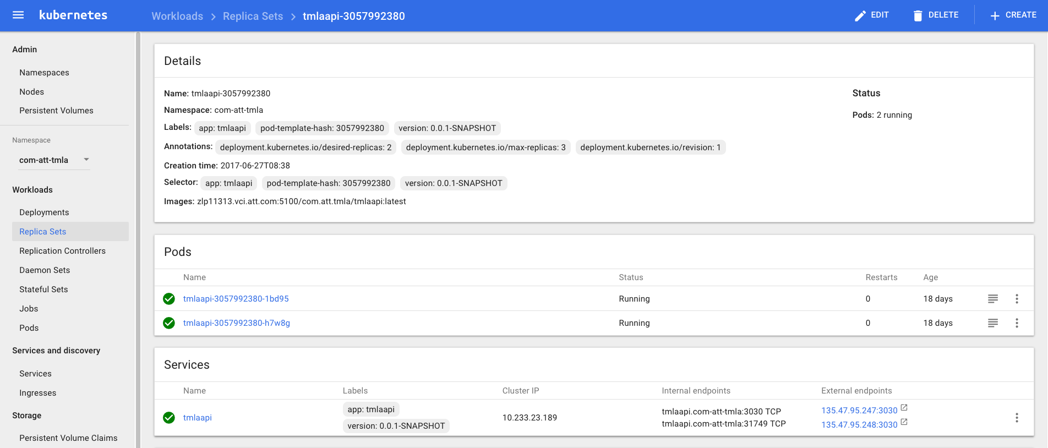
Kubernetes Architecture
Kubernetes First tour – Replica Sets - Details
Kubernetes: Overview
Notes:
In this example, there is a look inside tmlaapi replica sets details.
As you can see, it contains several bits of information, such as, name, namespace, labels, and the image the pods will be using.
In addition, you can see the name of the pods created by the replica set as well as the service associated with those pods.

Slide 23
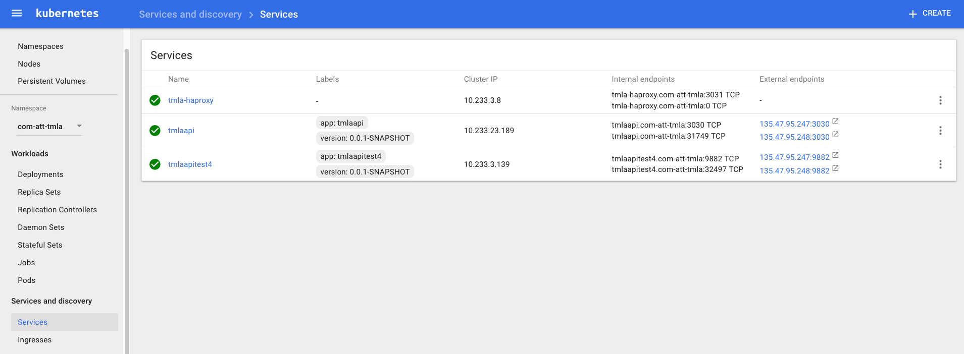
Kubernetes Architecture
Kubernetes First tour – Services
Kubernetes: Overview
Notes:
In this example, there are 3 different services assigned to each of the deployment workload.
tmla-haproxy is internal service for high availability.
tmlaapi, and tmlaapitest4 also have service for internal high availability as well as external IP endpoints.

Slide 24
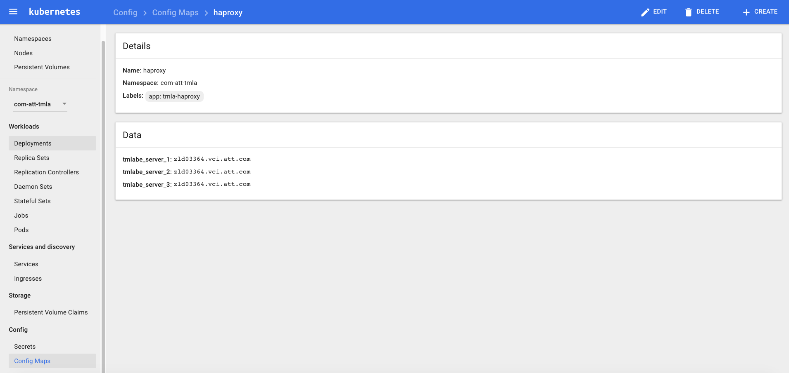
Kubernetes Architecture
Kubernetes First tour – Config Maps
Kubernetes: Overview
Notes:
In this example you can see a Config map for tmla-haproxy.
It contains the key/value pair of the different servers for which the haproxy will do load balancing.

Slide 25

Check Your Progress

Slide 26
Exercises
A+
Kubernetes: Overview
Kubernetes is orchestration tool support only Docker containers. | True/False
Which of these choices pertain to LABELS? Choose all options that apply. | Labels are Key/Value pairs that are attached to objects. Labels are intended to be used to specify identifying attributes of objects that are meaningful and relevant to users, but do not directly imply semantics to the core system. Labels can be used to organize and to select subsets of objects. Labels are used to store configuration files.

Slide 27
Contents
Kubernetes: An Overview
YAML files
AJSC6 Deployment
Cluster Management
Services, Load Balancing, and Networking

Slide 28
YAML Files
What is a YAML file?
YAML stands for "YAML Ain’t Markup Language."
It’s basically a human-readable structured data format.
It is less complex and ungainly than XML or JSON, but provides similar capabilities.
It allows you to provide powerful configuration settings.
---
apiVersion: extensions/v1beta1
kind: Deployment
metadata:
name: "${APP_NAME}"
namespace: "${APP_NS}"
labels:
app: "${APP_NAME}"
version: "${VERSION:-0.0.1}"
spec:
replicas: 2
selector:
matchLabels:
app: "${APP_NAME}"
version: "${VERSION:-0.0.1}"
template:
metadata:
labels:
app: "${APP_NAME}"
version: "${VERSION:-0.0.1}"
YAML Example
YAML Files

Slide 29
YAML Files
YAML vs Command Line
Pod, Services, etc., can be created using Kubectl command line with arguments or using YAML file.
Example for creating a pod using command line vs. YAML:
kubectl run nginx --image=nginx --replicas=1
kubectl create -f nginx_pod.yaml
--
apiVersion: v1
kind: Pod
metadata:
name: nginx
spec:
containers:
– name: nginx
image: nginx
YAML Files
Notes:
There are many ways to manage and configure Kubernetes, e.g., by API, GUI and CLI.
CLI has two options either by single command similar to Docker run command or using YAML files.
One of the benefits of using YAML files is that you can create in a single YAML
An application contains pods, replication Controller, Services, etc., instead of running multiple kubectl commands.

Slide 30
YAML files
AJSC6 ConfigMap YAML File - Example
Each YAML file should start with apiVersion and Kind.
The metadata contains the name of the ConfigMap module and to which namespace in the Kubernetes cluster it is belong.
The data contains the actual Key/Value pairs which holds the configuration we would like to be shared in the same Cluster (namespace).
In this example, we set a parameter name: config-env=dev
---
apiVersion: v1
kind: ConfigMap
metadata:
name: "tmlaapitest4"
namespace: "com-att-tmla"
data:
config-env: dev
YAML Files
Notes:
Let’s look at the ConfigMap.ymal file created by AT&T Eco for an AJSC6 container and understand the basics.
ConfigMap – Shared configuration key/value.
This YAML files will create a new Config map.

Slide 31
YAML files
AJSC6 Deployment YAML file – Example
Each YAML file should start with apiVersion and Kind.
The metadata contains the name of the ConfigMap module and to which namespace in the Kubernetes cluster it is belong.
The Label contains two labels, “app” and “version”.
---
apiVersion: extensions/v1beta1
kind: Deployment
metadata:
name: "tmlaapitest4"
namespace: "com-att-tmla"
labels:
app: "tmlaapitest4"
version: "0.0.1-SNAPSHOT"
YAML Files
Notes:
Here’s a look at Deployment.yaml file created by AT&T Eco for an AJSC6 container for understanding the basics.
Deployment - Contains the replication controller and pods configuration.
The template contains several parts:
Metadata - Contains the name of the deployment, the namespace and some labels we want to assign to the deployment.
Specs - Contains the actual information about our deployment. The first part is specification for number of pods we want to replicate. This will be used by the ReplicaSet component.
ServiceAccount - A service account provides an identity for processes that run in a pod. It is used for authentication of our API calls.
Containers - Set the configuration for the running containers in the pods.

Slide 32
YAML files
AJSC6 Deployment YAML file – Example, cont.
The spec contains the actual information about the deployment.
The replicas parameter contains how many pods are needed for the service.
The selector sets the labels of the deployment.
The template is a simply definitions of objects to be replicated in the case of pods.
spec:
replicas: 2
selector:
matchLabels:
app: "tmlaapitest4"
version: "0.0.1-SNAPSHOT"
template:
metadata:
labels:
app: "tmlaapitest4"
version: "0.0.1-SNAPSHOT"
spec:
serviceAccount: "com-att-tmla"
containers:
YAML Files
Notes:
The template contains several parts:
Metadata - Contains the name of the deployment, the namespace and some labels we want to assign to the deployment.
Specs - Contains the actual information about our deployment. The first part is specification for number of pods we want to replicate. This will be used by the ReplicaSet component.
ServiceAccount - A service account provides an identity for processes that run in a pod. It is used for authentication of our API calls.
Containers - Set the configuration for the running containers in the pods.

Slide 33
YAML files
AJSC6 Deployment YAML file – Example
The envy contains the information to start the container.
The “valueFrom” maps the containers environment variable ENV to the value in the ConfigMap.
The “image” contains the location of the Docker image the container will be using.
The “imagePullPolicy” means always go to Docker Registry to pull the image.
The “ports” set on which ports the container will be listening on.
The “restartPolicy” means that if pod is down for some reason it will automaticity started.
- env:
- name: ENV
valueFrom:
configMapKeyRef:
key: config-env
name: "tmlaapitest4"
image: "zlp11313.vci.att.com:5100/com.att.tmla/tmlaapitest4:latest"
imagePullPolicy: Always
name: "tmlaapitest4"
ports:
- containerPort: 8080
protocol: TCP
restartPolicy: Always
---
YAML Files
Notes:
The template contains several parts:
Metadata - Contains the name of the deployment, the namespace and some labels we want to assign to the deployment.
Specs - Contains the actual information about our deployment. The first part is specification for number of pods we want to replicate. This will be used by the ReplicaSet component.
ServiceAccount - A service account provides an identity for processes that run in a pod. It is used for authentication of our API calls.
Containers - Set the configuration for the running containers in the pods.

Slide 34
YAML files
AJSC6 Service YAML file - Example
This YAML file contains only service module.
Each YAML file should start with apiVersion and Kind.
The metadata contains the name of the ConfigMap module and to which namespace in the Kubernetes cluster it is belong.
The Label contains two labels, “app” and “version.”
The spec contains the actual information about our service.
”type” - which service we would like to assign to our pod; in this case, a shared port.
“ports” - the mapping between our service port to the pod’s containers port.
“selector” - sets the labels of the ports.
---
apiVersion: v1
kind: Service
metadata:
name: "tmlaapitest4"
namespace: "com-att-tmla"
labels:
app: "tmlaapitest4"
version: "0.0.1-SNAPSHOT"
spec:
type: NodePort
ports:
- name: http
port: 80
protocol: TCP
targetPort: 8080
selector:
app: "tmlaapitest4"
version: "0.0.1-SNAPSHOT"
YAML Files

Slide 35
Check Your Progress

Slide 36
Exercises
A+
YAML Files
What is missing in the following YAML file to create replication of 3 pods? apiVersion: apps/v1beta1 kind: Deployment metadata: name: nginx-deployment spec: template: metadata: labels: app: nginx spec: containers: - name: nginx image: nginx:1.7.9 ports: - containerPort: 80 | Replicas: 3 RollingUpdate: 3 Pods: 3

Slide 37
Contents
Kubernetes: Overview
YAML files
AJSC6 Deployment
Cluster Management
Services, Load Balancing, and Networking

Slide 38
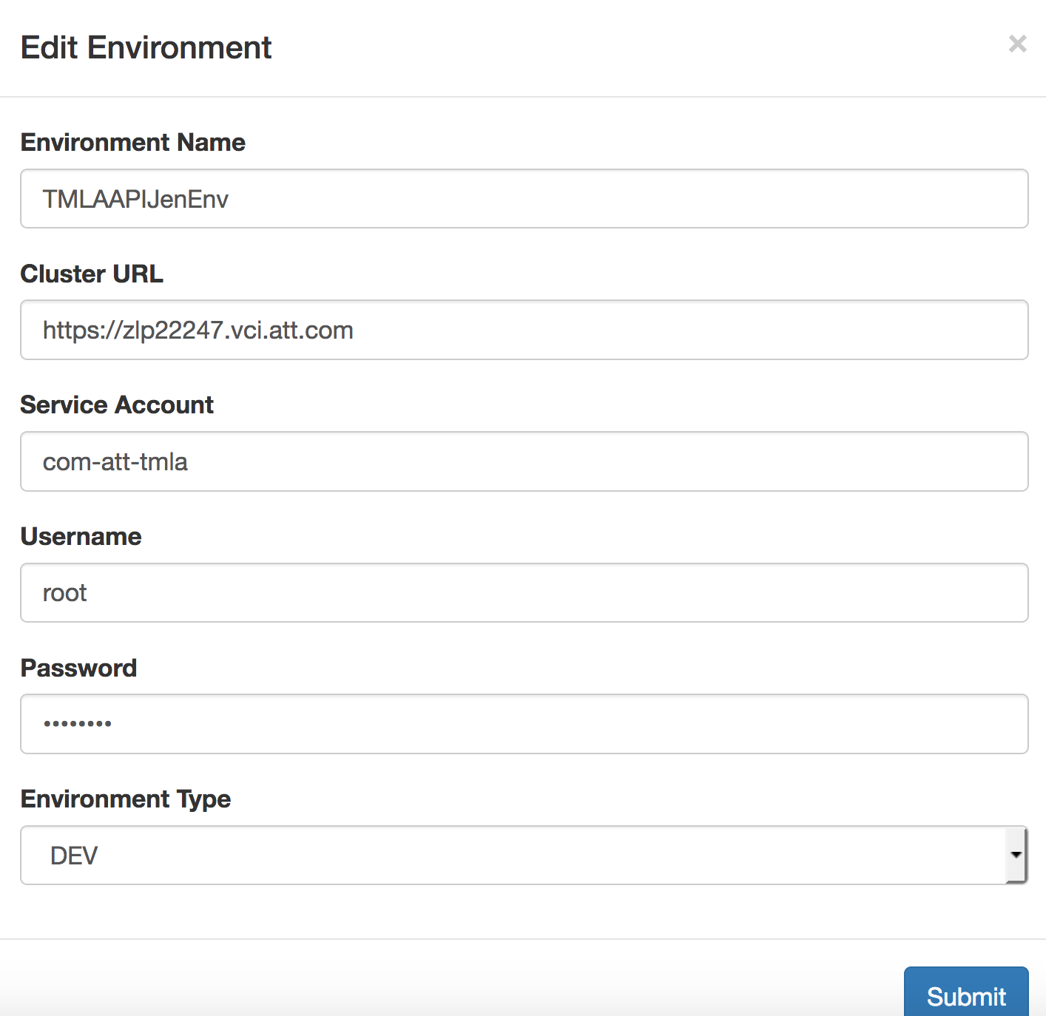
AJSC6 Deployment
AT&T Eco Setup
When creating a new “seed” in AT&T Eco you should specify the Kubernetes cluster information in the “System Connections” section under “Environment Tab.”
You should enter the Master node FQDN and credentials.
You should also specify the ServiceAccount that should match the same serviceAccount in the Kubernetes environment.
AJSC6 Deployment
Notes:
AJSC6 Deployment

Slide 39
AJSC6 Deployment
AT&T Eco – Kubernetes Deployment
Once you created a new AJSC6 ”seed” you can find the following files created for you in the code repository.
Under k8s directory, there will be these files:
cfgmap.tpl.yml - a generic template for creating Kubernetes ConfigMap
svc.tpl.yaml - a generic template for creating Kubernetes Service
deployment.tpl.yml - a generic template for creating Kubernetes ConfigMap and Deployment
deploy.sh – a script that Jenkins pipeline is running to deploy your AJSC6 service into the Kubernetes environment
AJSC6 Deployment

Slide 40
AJSC6 Deployment
deployment.tpl.yml
---
apiVersion: extensions/v1beta1
kind: Deployment
metadata:
name: "${APP_NAME}"
namespace: "${APP_NS}"
labels:
app: "${APP_NAME}"
version: "${VERSION:-0.0.1}"
spec:
replicas: 2
selector:
matchLabels:
app: "${APP_NAME}"
version: "${VERSION:-0.0.1}"
template:
metadata:
labels:
app: "${APP_NAME}"
version: "${VERSION:-0.0.1}"
spec:
serviceAccount: "${SERVICE_ACCOUNT:-default}"
containers:
- env:
- name: ENV
valueFrom:
configMapKeyRef:
key: config-env
name: "${APP_NAME}"
image: "${IMAGE_NAME}"
imagePullPolicy: Always
name: "${APP_NAME}"
ports:
- containerPort: 8080
protocol: TCP
restartPolicy: Always
AJSC6 Deployment
Notes:
This file can be found in your k8s folder under the AJSC6 Git repository.
As stated in the previous slide, it is used to create the deployment, replica sets and pods.
Some of the information is environment variables, which will be populated as part of the Jenkins Jobs run.

Slide 41
AJSC6 Deployment
cfgmap.tpl.yml
---
apiVersion: v1
kind: ConfigMap
metadata:
name: "${APP_NAME}"
namespace: "${APP_NS:-default}"
data:
config-env: dev
AJSC6 Deployment
Notes:
This file can be found in your k8s folder under the AJSC6 Git repository.
As stated in the previous slide it is used to create the Config map attributes.
In this example you can see that it will add a configuration parameter “config-env” equal the value: “dev“
Some of the information is environment variables which we’ll be populate part of the Jenkins Jobs run.

Slide 42
AJSC6 Deployment
svc.tpl.yml
---
apiVersion: v1
kind: Service
metadata:
name: "${APP_NAME}"
namespace: "${APP_NS}"
labels:
app: "${APP_NAME}"
version: "${VERSION:-0.0.1}"
spec:
type: NodePort
ports:
- name: http
port: 80
protocol: TCP
targetPort: 8080
selector:
app: "${APP_NAME}"
version: "${VERSION:-0.0.1}"
AJSC6 Deployment
Notes:
This file can be found in your k8s folder, under the AJSC6 Git repository.
As stated in the previous slide, it is uses to create a load balancing service for your Pods.
In this example, you can see that it will add a new load balancing service which will listen on port 80 and will redirect the traffic to port 8080 in each of the Pods.
Some of the information is environment variables, which will be populated as part of the Jenkins Jobs run.

Slide 43
AJSC6 Deployment
AT&T Eco – AJSC6 Kubernetes
Upon successful pipeline, the following topology will be added to the Kubernetes cluster:
New service listening on port 80
A Replication set of 2 pods
2 pods
Shared ConfigMap
Service
Replica set
Pod #1
Pod #2
Config Map
AJSC6 Deployment

Slide 44
AJSC6 Deployment
GRMEdge
The CDP runtime environment contains GRMEdge service. This service is used to register any AJSC6 application into GRM environment.
As soon as the AJSC6 pod is up it is also registered in GRM.
The GRM environment is configured in the CDP runtime namespace: com-att-ocnp-mgmt
ConfigMap : grmedge-config
CPFRUN_GRMEDGE_DEFAULT_ENV=PROD
CDP Runtime
GRM
AJSC6
GRMEdge
AJSC6 Deployment
Notes:
TBD – Add text

Slide 45
Check Your Progress

Slide 46
Exercises
A+
AJSC6 Deployment
What is the Kubernetes workload AJSC6 is using? | Replication Controllers Daemon Sets Deployments Stateful Sets
What is the purpose of GRMEdge deployment? | Manage the Kubernetes cluster Register AJSC6 pods into GRM Register AJSC6 pods into AT&T Registry Manage the Global Replication Manager

Slide 47
Contents
Kubernetes: Overview
YAML files
AJSC6 Deployment
Cluster Management
Services, Load Balancing, and Networking

Slide 48
Cluster Management
Kubectl get
Kubectl is Kubernetes command like tool used to manage the cluster.
Kubectl can be used to create new objects, gather information and perform various activity on the running cluster.
Kubectl GET Example:
Get information for deployments, services and pods on the cluster namespace:
# Kubectl get deployments,services,pods – namespace com-att-tmla
The expected result will be the current deployments, services and pods running on namespace called com-att-tmla.
Cluster Management

Slide 49
Cluster Management
Kubectl Create
Kubectl Create Example:
Create new deployment using a YAML File:
# Kubectl create –f nginx.yaml –namespace com-att-tmla
The expected result will be the new deployment under the namespace com-att-tmla.
Cluster Management

Slide 50
Cluster Management
Kubectl Replace
Kubectl Replace Example:
Replace Docker image on running cluster (Rolling Update) using new updated YAML File.
# kubectl replace -f new-nginx.yaml --namespace com-att-tmla
The expected result will rolling update of the pods associate with this deployment under com-att-tmla namespace.
More information about kubectl can be found by running the command.
# kubectl help
Cluster Management

Slide 51
Cluster Management
CDP Runtime Tools
Kubernetes Dashboard
Prometheus Dashboard
Kibana Dashboard
Grafana Dashboard
Alert Manager Dashboard
Cluster Management
Notes:
When using CDP Kubernetes runtime environment, the following tools will be added to your cluster, helping you manage your cluster.

Slide 52
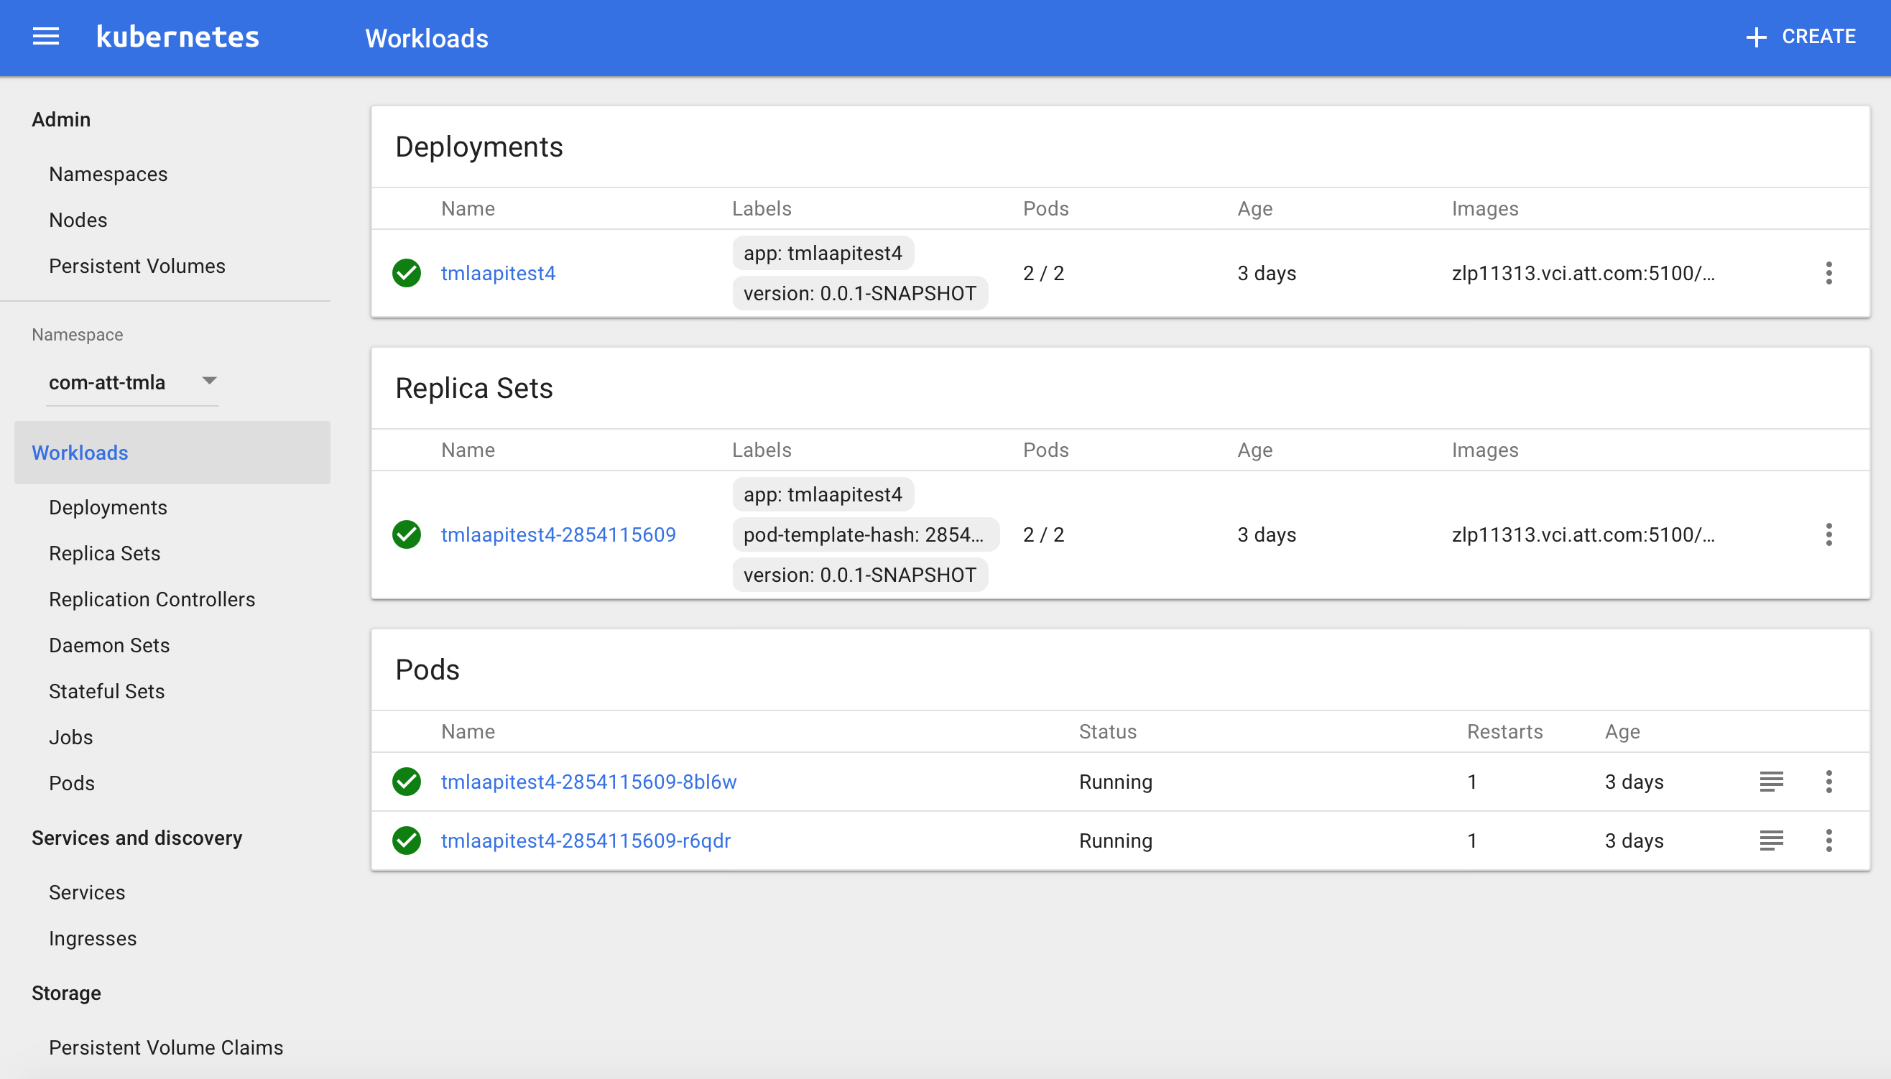
Cluster Management
CDP Runtime – Kubernetes Dashboard
The Kubernetes dashboard can be used to view the containers logs in a centralized location.
Cluster Management
Notes:
Kubernetes can be managed also via GUI.
The Kubernetes dashboard provides deployment information and tools to manage it.
You can create, modify or view objects

Slide 53
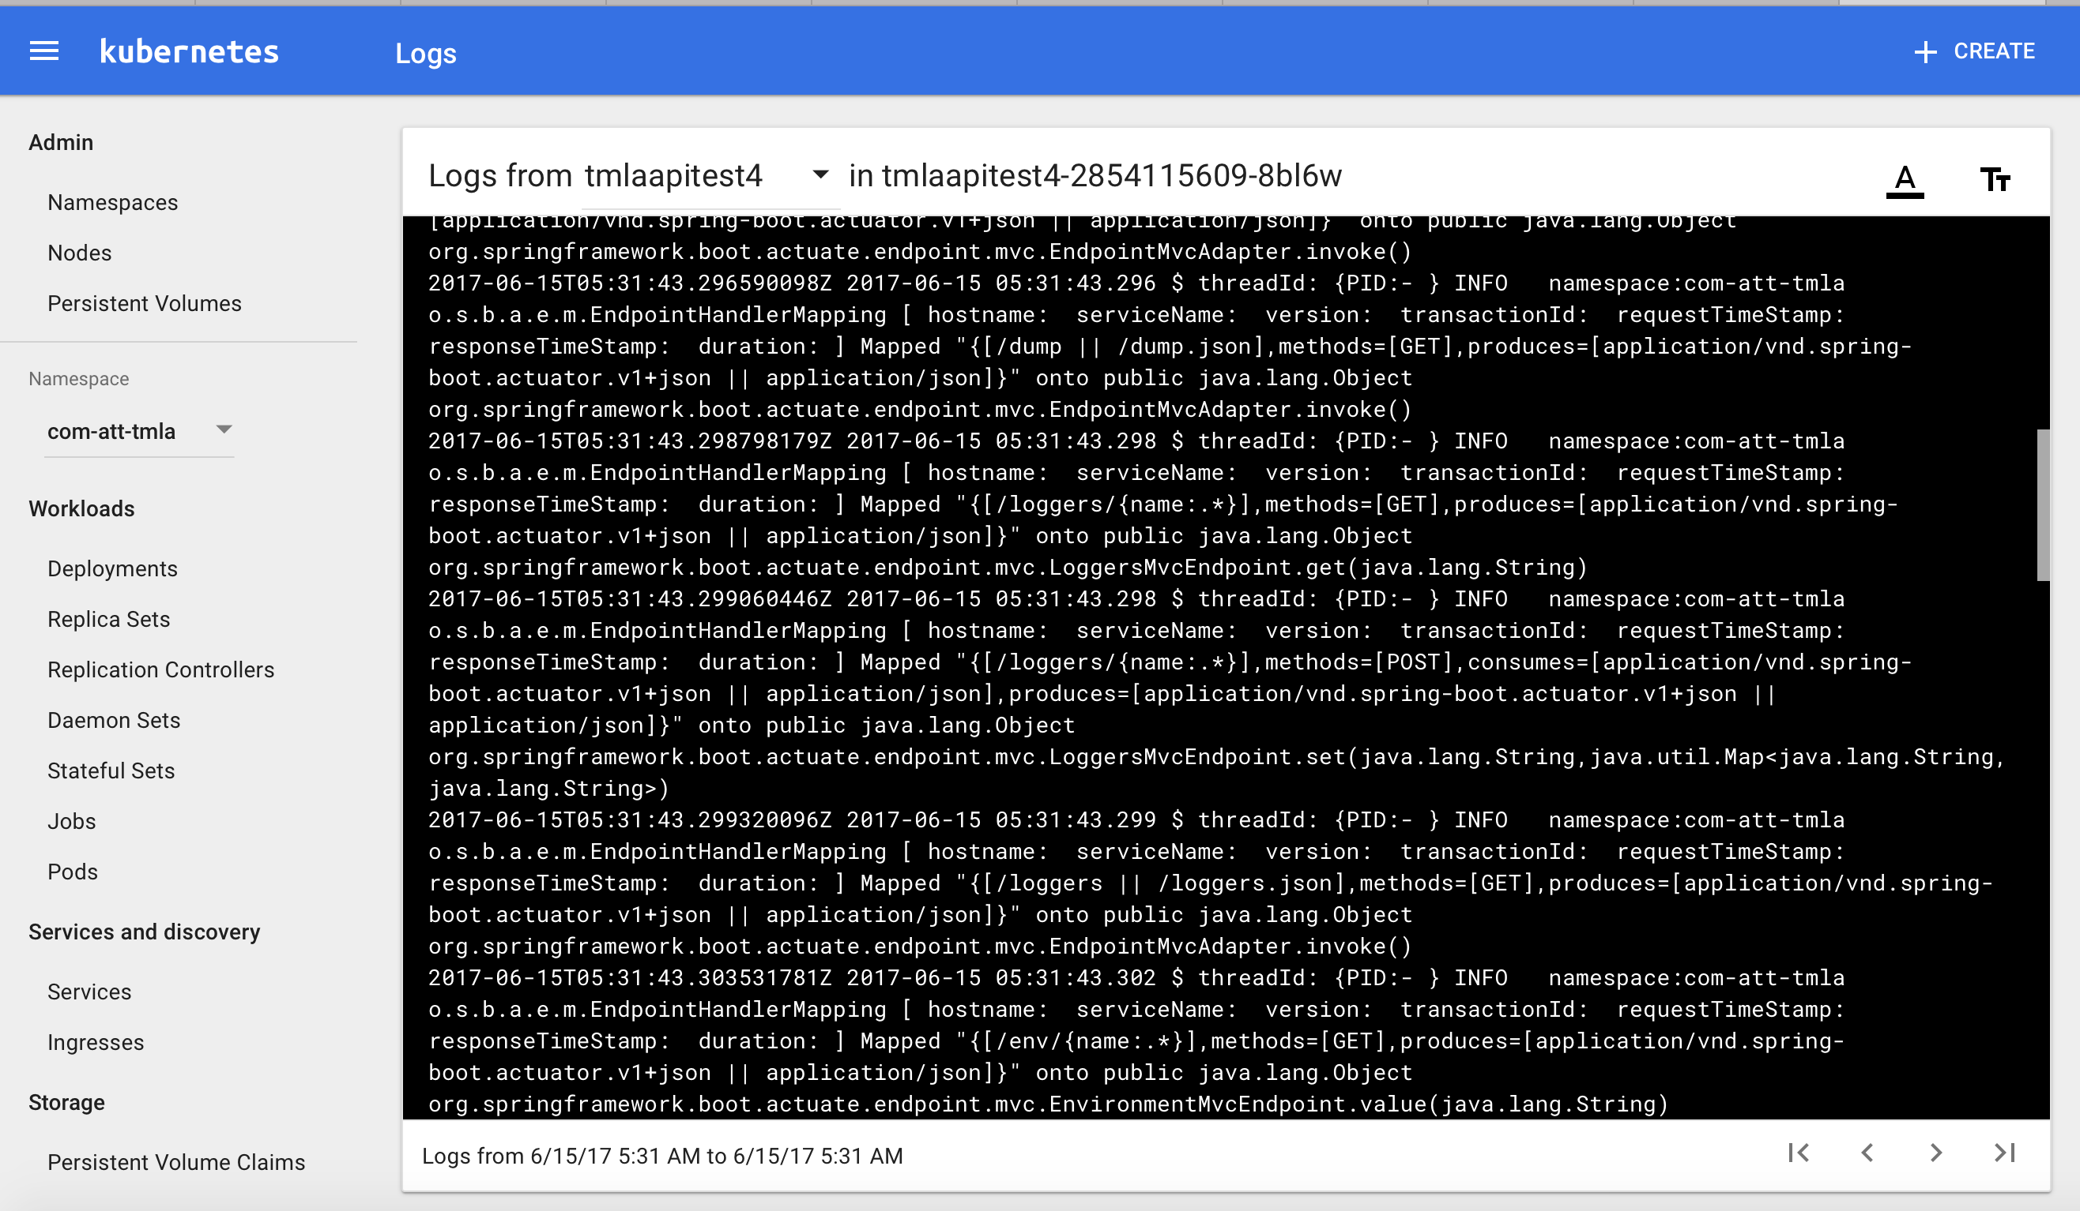
Cluster Management
CDP Runtime – Kubernetes Dashboard – Logs
The Kubernetes dashboard can be used to view the containers logs in a centralized location.
Cluster Management
Notes:
The Kubernetes dashboard can be used to view the containers logs in a centralized location.

Slide 54
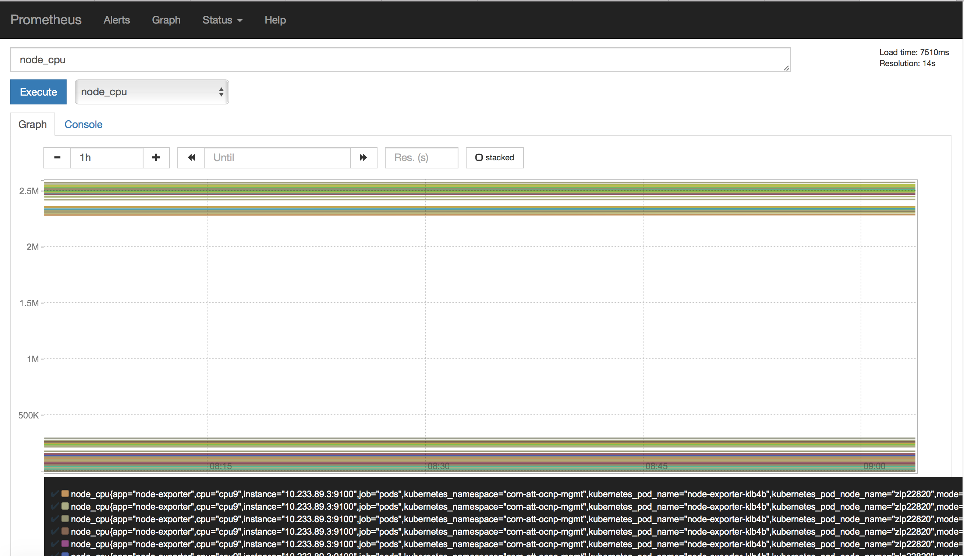
Cluster Management
CDP Runtime – Prometheus Dashboard
Prometheus provides complete container cluster monitoring: instrumentation, collection, querying, and alerting.
Cluster Management
Notes:
Prometheus provides complete container cluster monitoring: instrumentation, collection, querying, and alerting.
Monitoring is an integral part of ensuring infrastructure reliability and performance through observability.
Prometheus is a unified approach to monitoring all the components of a Kubernetes cluster, including the control plane, the worker nodes, and the applications running on the cluster.

Slide 55
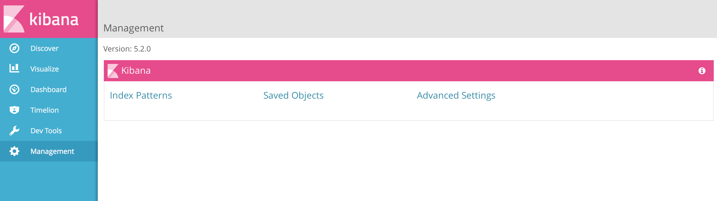
Cluster Management
CDP Runtime – Kibana Dashboard
Kibana is a tool to visualized logs information. It can be used to visualize the applications logs.
Cluster Management
Notes:
Kibana is a tool to visualized logs information. It can be used to visualized the applications logs.

Slide 56
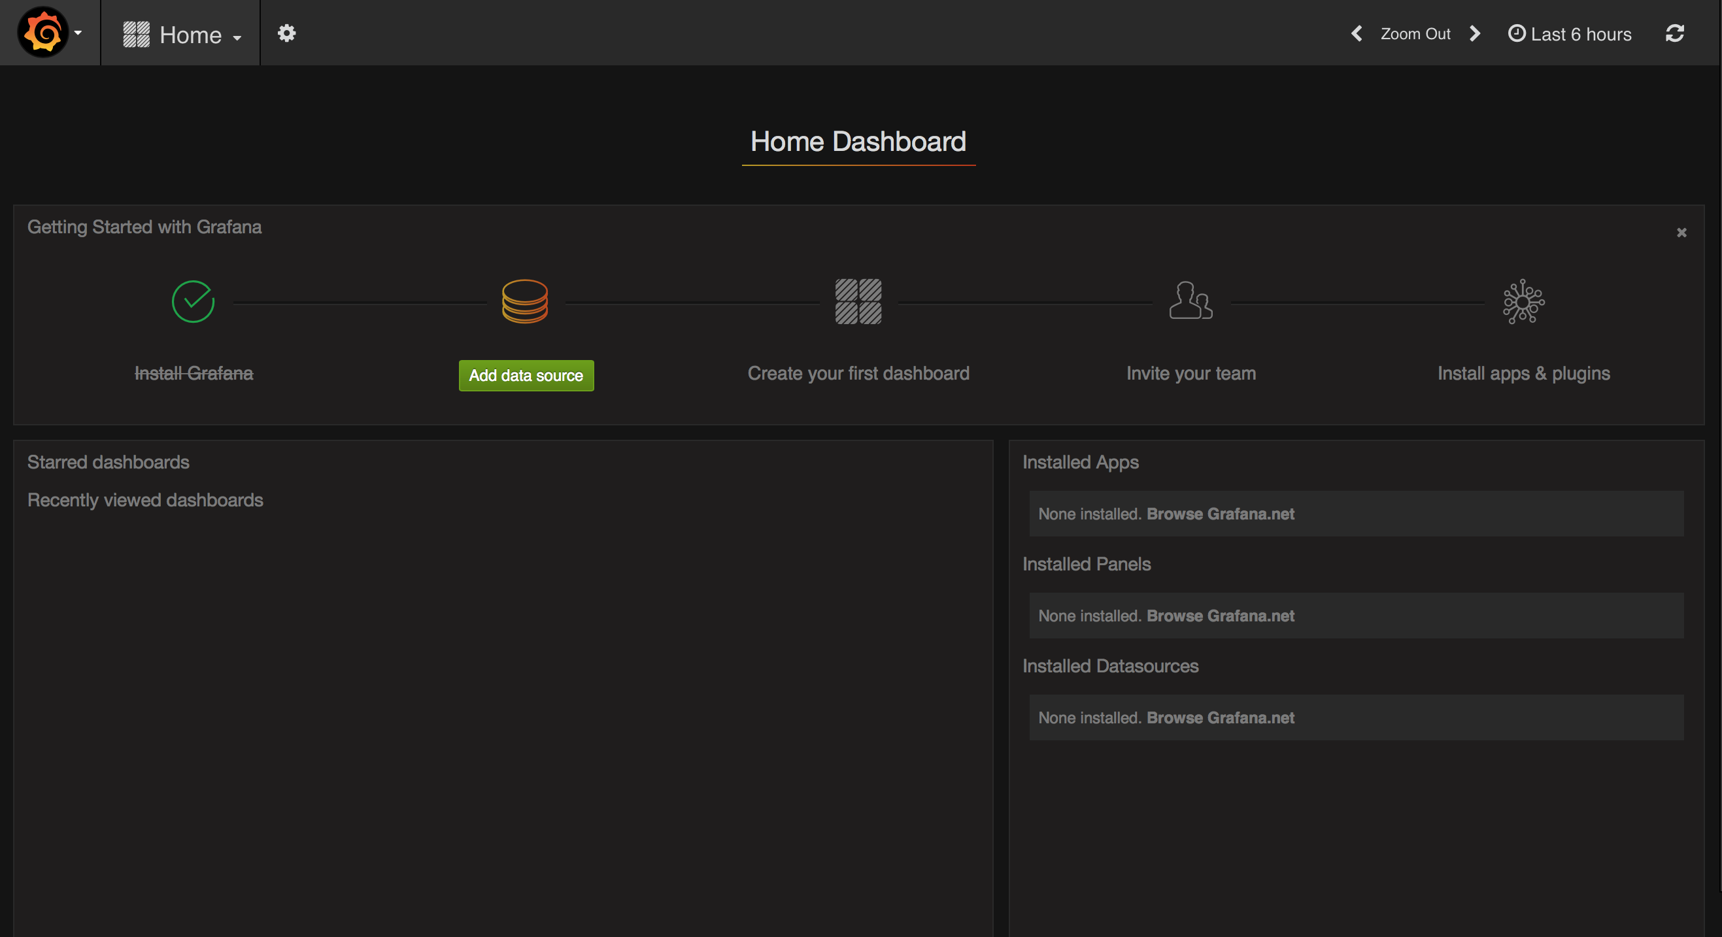
Cluster Management
CDP Runtime – Grafana Dashboard
The Grafana Kubernetes app allows the monitoring of the Kubernetes cluster's performance.
Cluster Management
Notes:
The Grafana Kubernetes app allows the monitoring of the Kubernetes cluster's performance.

Slide 57
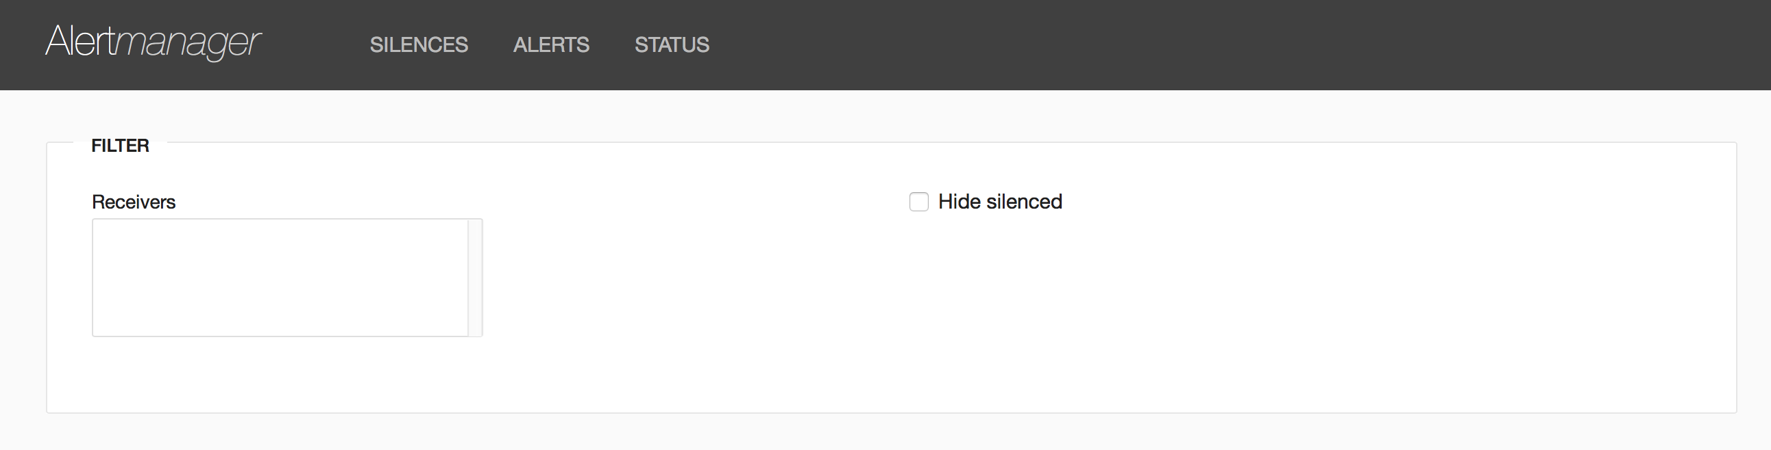
Cluster Management
CDP Runtime – Alertmanager Dashboard
The Alertmanager dashboard – It can be used to create new alerts on the system and configure recipients for those alerts.
Cluster Management
Notes:
The Alertmanager dashboard – It can be used to create new alerts on the system and configure recipients for those alerts.

Slide 58
Check Your Progress

Slide 59
Exercises
A+
Cluster Management
Which tool is used to monitor the performance of the Kubernetes cluster? | Prometheus Kibana Grafana Alert Manager Runmeter
“Kubectl replace” is used for (mark all answers). | Replace an object Perform Rolling update Replace Kubernetes version Replace files on the node file system

Slide 60
Contents
Kubernetes: An Overview
YAML files
AJSC6 Deployment
Cluster Management
Services, Load Balancing, and Networking

Slide 61
Services, Load Balancing, and Networking
Networking
Kubernetes uses a private vLAN for the cluster management and Pods traffic.
Basic concepts:
all containers can communicate with all other containers without NAT.
all nodes can communicate with all containers (and vice-versa) without NAT
the IP that a container sees itself as is the same IP that others see it as
Private vLAN
Host 1
Host 2
Host 3
Services, Load Balancing, and Networking

Slide 62
Services, Load Balancing, and Networking
Services
A Kubernetes Service is an abstraction which defines a logical set of Pods and a policy by which to access them.
It is like a load balancer service for your pods.
It uses internal DNS so pods can communicate with other services across the cluster.
It can be accessed on the private vLAN or used External Host IP addresses .
Service (80/TCP)
Pod 1 (8080/TCP)
Pod 2
(8080/TCP)
Pod 3
(8080/TCP)
Services, Load Balancing, and Networking

Slide 63
Services, Load Balancing, and Networking
AJSC6 Service example with External IPs
2 Pods – tmlaapitest4 listening on port 9882/TCP
1 Service – tmlaapitest4 listening on port 9882/TCP with two Pods
2 External IPs associate to the service tmlaapitest4
Service “tmlaapitest4” (9882/TCP)
Master1
Master2
Node1
Node2
Node3
Tmlaapitest4 (9882/tcp)
Tmlaapitest4 (9882/tcp)
EXTERNAL IP1
EXTERNAL IP2
Services, Load Balancing, and Networking
Notes:
In the following example we’ll show how to create a service that load balance traffic between two pods and has external IP addresses expose to the service

Slide 64
Services, Load Balancing, and Networking
AJSC6 Service example with External IPs – User Flow
User run API Call
External Load Balancer
Kubernetes Cluster
Master1
Master2
Node1
Node2
Node3
EXTERNAL IP1:9882/tcp
EXTERNAL IP2:9882/tcp
Tmlaapitest4 (9882/tcp)
Tmlaapitest4 (9882/tcp)
Service “tmlaapitest4” (9882/TCP)
Services, Load Balancing, and Networking
Notes:
A user create an API call to an external Load Balancer.
The Load Balancer then send the traffic to one of the Kubernetes External IP and Port associate with the new service, in our example port 9882/TCP
The External IP address is map to a service, the service now locate available pod.
The Service is now transfer the request to one of the Pods, in our example the pod expose also port 9882/TCP

Slide 65
Services, Load Balancing, and Networking
AJSC6 Service example with External IPs – YAML File
apiVersion: v1
kind: Service
metadata:
name: tmlaapitest4
namespace : tmlaapitest4
labels:
app: tmlaapitest4
version: 0.0.1-SNAPSHOT
name: tmlaapitest4
spec:
externalIPs:
- 135.47.95.247
- 135.47.95.248
type: NodePort
ports:
- name: http
port: 9882
protocol: TCP
targetPort: 9882
selector:
app: tmlaapitest4
version: 0.0.1-SNAPSHOT
Services, Load Balancing, and Networking
Notes:
This example will create the topology in the previous slides.

Slide 66
Services, Load Balancing, and Networking
AJSC6 Service example with External IPs – Kubectl
$ kubectl get svc tmlaapitest4 -n com-att-tmla
NAME CLUSTER-IP EXTERNAL-IP PORT(S) AGE
tmlaapitest4 10.233.3.139 135.47.95.247,135.47.95.248 9882:32497/TCP 70d
Using Kubectl to get the service information.
Services, Load Balancing, and Networking
Notes:
Following the creation of the service topology, this is what the expected result of ”get svc” command will look like.

Slide 67
Services, Load Balancing, and Networking
AJSC6 Service example with External IPs – Kubectl Describe
$ kubectl desc ribe svc tmlaapitest4 -n com-att-tmla
Name: tmlaapitest4
Namespace: com-att-tmla
Labels: app=tmlaapitest4
version=0.0.1-SNAPSHOT
Selector: app=tmlaapitest4,version=0.0.1-SNAPSHOT
Type: NodePort
IP: 10.233.3.139
External IPs: 135.47.95.247,135.47.95.248
Port: http 9882/TCP
NodePort: http 32497/TCP
Endpoints: 10.233.121.9:9882,10.233.127.10:9882
Session Affinity: None
Services, Load Balancing, and Networking
Notes:
Following the creation of the service topology this is the expected result of ”describe svc” command will looks like

Slide 68
Services, Load Balancing, and Networking
AJSC6 Service & DME2
The default setup of the AJSC6 Seed created by AT&T Eco doesn’t provide External IPs.
It just creates an internal service cluster IP. Another way to expose the new service is by using DME2 Proxy on the Cluster.
Service “tmlaapitest4” (80/TCP)
Node1
Node2
Node3
Tmlaapitest4 (8080/TCP)
Tmlaapitest4 (8080/TCP)
DME2 Pod + External IP
Services, Load Balancing, and Networking

Slide 69
Check Your Progress

Slide 70
Exercises
A+
Services, Load Balancing, and Networking
Kubernetes uses internal DNS for it services | True/False
Kubernetes uses the host networking IPs for internal traffic between pods. | True/False

Slide 71
Answers to Exercises

Slide 72
Exercises
A+
Kubernetes: Overview
Kubernetes is orchestration tool supports only Docker containers. No. Kubernetes is a container management system that supports several container types, including but not limited to, Docker. | False
Which of these choices pertain to LABELS? A, B and C. | Key/Value pairs that are attached to objects Labels are intended to be used to specify identifying attributes of objects that are meaningful and relevant to users, but do not directly imply semantics to the core system. Labels can be used to organize and to select subsets of objects. Labels can be used to store configuration files.

Slide 73
Exercises
A+
YAML Files
What is missing in the following YAML file to create replication of 3 pods? apiVersion: apps/v1beta1 kind: Deployment metadata: name: nginx-deployment spec: template: metadata: labels: app: nginx spec: containers: - name: nginx image: nginx:1.7.9 ports: - containerPort: 80 | Replicas: 3 RollingUpdate: 3 Pods: 3

Slide 74
Exercises
A+
AJSC6 Deployment
What is the Kubernetes workload AJSC6 is using? | Replication Controllers Daemon Sets Deployments Stateful Sets
What is the purpose of GRMEdge deployment? | Manage the Kubernetes cluster Register AJSC6 pods into GRM Register AJSC6 pods into AT&T Registry Manage the Global Replication Manager

Slide 75
Exercises
A+
Cluster Management
Which tool is used to monitor the performance of the Kubernetes cluster? | Prometheus Kibana Grafana Alert Manager Runmeter
“Kubectl replace” is used for (mark all answers). | Replace an object Perform Rolling update Replace Kubernetes version Replace files on the node file system

Slide 76
Exercises
A+
Services, Load Balancing, and Networking
Kubernetes uses internal DNS for it services | True
Kubernetes uses the host networking IPs for internal traffic between pods. | False

